Slide 1
Time Domain Analysis Tool
Semester Project Presentation
Ehsan Ghaneie
Ken Waller
EEL 6883 – Software Engineering II
Spring 2007

Slide 2
Presentation Agenda
Project Overview/Purpose
Project Metrics
Project Deliverables
Description of 3rd Party Software Packages used
Software Development Model
System Design (Architectural and Detailed)
Difficulties Encountered and Lessons Learned
System Demonstration
Questions and Answers

Slide 3
Project Overview and Purpose
Generate Time-Domain plots
  Circuit
  Data File
Dynamically “Tune” the circuit parameters and observe the result in both domains in a real-time manner
Other features…

Slide 4
Project Metrics - Documentation
Document Name | Number of Pages | Number of Diagrams
Project Proposal/Description | 2 | 0
Concept of Operations (CONOPS) | 14 | 10 (1 Sequence)
Software Requirements | 6 | 0
Project Management Plan | 6 | 3
Architectural Design | 12 | 13 (3 Package, 7 Use Case, 1 Sequence)
Detailed Design | 18 | 19 (11 Class, 8 Sequence)
Test Plan | 13 | 18
User's Manual | 5 | 7
System Installation | 1 | 0
System Requirements | 1 | 0
Totals | 78 | 70 (31 UML: 3 Package, 7 Use Case, 10 Sequence, 11 Class)
Only Highlights shown in this Presentation

Slide 5
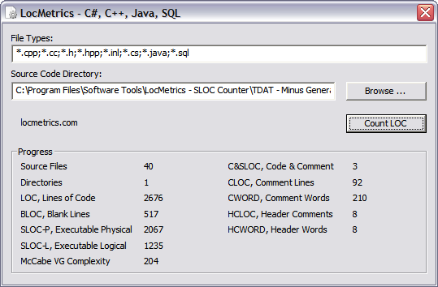
Project Metrics – Source Code
Some additional metrics
  Number of OO-classes: 19
  Number of Requirements: 22
  Number of printed pages of source code (*.cpp/*.h): 63

Slide 6
Project Deliverables
Documentation
  Project Proposal/Description Document
  Concept of Operations (CONOPS) Document
  Software Requirements Document
  Project Management Plan Document
  Architectural (High-Level) Design Document
  Detailed Design Document
  Test Plan Document
  User’s Manual Document
  System Installation Document
  System Requirements Document
  Project Presentation Slides
  Microsoft Visio Drawings and UML Model
Software
  C++ Source Code (*.cpp/*.h files)
  All Visual Studio Project Related Files
  Executable Program File and any Additional Dynamic Link Libraries (DLL)

Slide 7
3rd Party Software Packages
Qt
  From TrollTech
  Object-Oriented C++ package for GUI development
  Open Source, freely available V 4.2.2 used
Qwt
  Available from SourceForge
  Extension of Qt that added ability to plot graphs
  Open Source, freely available V 5.0.1 used
FFTW (Fast Fourier Transform of the West)
  Available from MIT
  C-based library that assists with FFT computations/algorithms
Helped reduce Development risks, but introduced learning curve risk

Slide 8
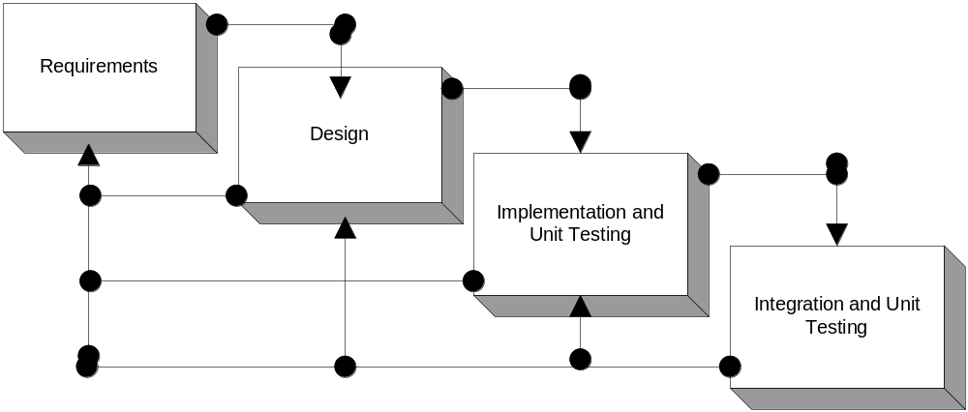
Software Development Model
Modified Waterfall (Hybrid)
  Would have used Spiral, but time constraints prevented its use
  Integrates some aspects of Spiral
  Notes:
    CONOPS developed to help ID requirements (pen and paper, then formal capture)
    Design split into two phases: architectural and detailed

Slide 9
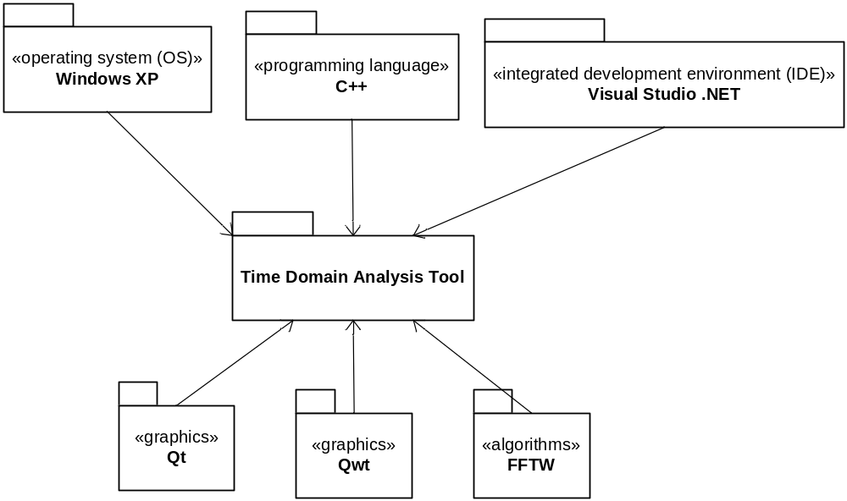
System Architecture Design – Package Diagram

Slide 10
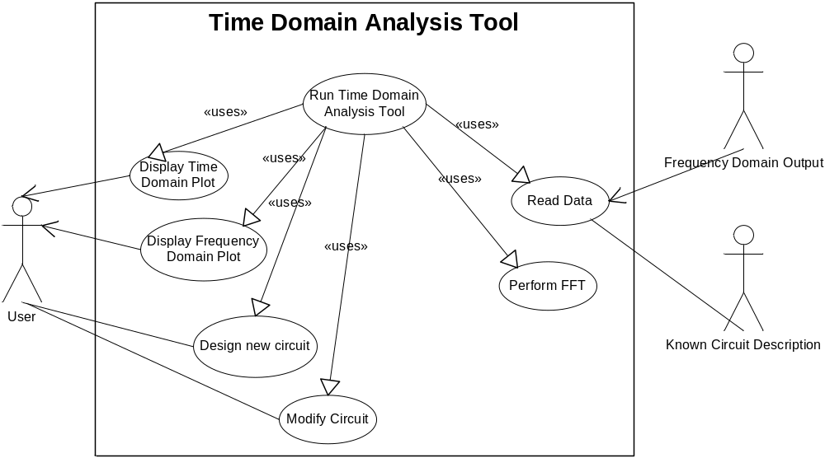
System Architecture Design – Use Case Model

Slide 11
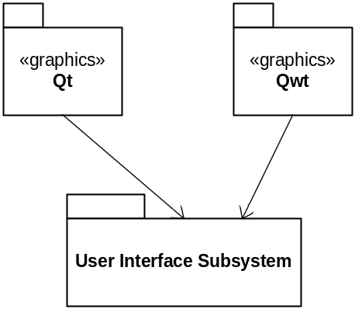
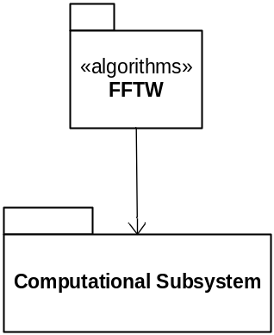
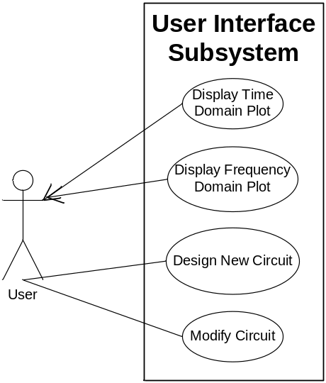
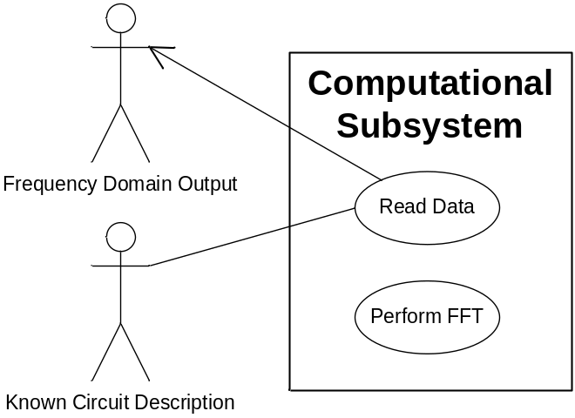
System Architecture Design – Subsystem Breakdown

Slide 12
System Detailed Design - Strategy
Define the Static Model
  Use UML Class Diagrams
  Assign each class to a subsystem
  Define inheritance, associative, and compositional relationships
  Define methods
Define Dynamic Model
  Use UML Sequence Diagrams
  Create a Sequence Diagram for each Use Case
See Word document for a quick review

Slide 13
Difficulties and Lessons Learned
Identifying, installing and configuring 3rd Party Software
  Appropriate versions and licenses had to be considered
Learning how to use 3rd Party Software
  Hundreds of OO classes provided
  Documentation and examples were a huge help
Lesson Learned: Tradeoffs!
  Reduced Development Risks, but increased Personnel/Training risks
  “No free lunch!”

Slide 14
Demonstration Time!
Live execution of the resulting software application now demonstrated…

Slide 15
Questions/Comments?
Thank you!

